Slide 1

PHILIPS MR TEAM · SPEC-DRIVEN AGENTIC AI · UPDATED PROPOSAL
Spec-Driven Agentic AI
Training Proposal
Spec → Plan → Task → Code · Guardrails Throughout · 2-Day Intensive
Spec-Driven Agentic AI · Philips MR Team · Bangalore · In-Person · 2-Day Bootcamp

Slide 2
INPUTS RECEIVED — HOW THIS PROPOSAL IS ALIGNED
Philips MR · Spec-Driven Agentic AI
Your Inputs → Our Response, Point by Point
→ Spec-driven development is the spine: Spec → Plan → Task → Code → Executed
Day 1 Session 1 teaches the full chain and how to author a spec an agent can execute. Every later lab starts from a spec, not a prompt.
DONE
→ Enterprise platform: Azure OpenAI or AWS Bedrock, Copilot — guardrails already in place
All labs run inside the Philips-approved cloud boundary — Azure OpenAI or AWS Bedrock, with GitHub / M365 Copilot where licensed. Existing tenant guardrails are used as the baseline and extended, not replaced.
DONE
→ Domain: Regulated Magnetic Resonance — internal operational efficiency use cases
Programme is anchored to internal MR operations. A case study — to be shared by the MR team — is issued to each pod; the architecture and guardrail pattern stay identical whatever the workflow.
PENDING USE CASES
DONE
→ 2 full days, 4 sessions — build in Day 1, harden and attack in Day 2
Day 1: spec-driven development + agentic orchestration, then hands-on agent build from their own spec. Day 2: guardrails and harnesses, then a pod-versus-pod break session.
DONE
→ Senior cohort — managers, directors, strategic developers, programme managers
30 participants in 10 pods of 3. Managers, directors, strategic developers and programme managers, 10–15 years' experience averaging 20. No fundamentals — architecture, delivery risk and review discipline.
DONE
→ Agentic orchestration and a working MCP agent must be included
Orchestration patterns — orchestrator plus domain agents, typed handoffs, failure modes — are taught in Day 1 Session 1. A custom MCP agent is a mandatory build deliverable in Day 1 Session 2.
DONE
→ Strong hands-on: build it, then try to break it
70% of programme time is lab. Day 2 Session 2 is an adversarial exchange: each pod hands its agent to another pod to break — prompt injection, tool hijack, data exfiltration — and then fixes what fell over.
DONE
→ Data protection in a regulated environment — controls, classification, auditability
Day 2 covers classification of MR operational data, context-window hygiene, PHI boundaries, tenant-level policy controls and a full structured audit trail — all applied to the systems built in the room.
DONE
Remaining input from Philips: the MR team to share the case study. Everything else is ready to lock.

Slide 3
2-DAY PROGRAMME AT A GLANCE
Philips MR · Spec-Driven Agentic AI
Programme at a Glance
Day 1 builds the spec and the agents; Day 2 hardens them with guardrails, harnesses and a pod-vs-pod break session.
DAY 1 · Spec-Driven Build
DAY 2 · Guardrails, Harnesses & Break It
S0 Kickoff + Toolchain Check
S1 Spec → Plan → Task → Code → Executed
S2 How to Write the Spec
S3 Agentic Orchestration
S4 Hands-On: Build Your Agents + MCP Agent
S5 Day 1 Recap + Threat Landscape
S6 Build Guardrails — All 4 Layers
S7 Harnesses, Evals and CI Gates
S8 Break It — Pod 1 Hands Its Agent to Pod 2
S9 Governance + Responsible Use + Data Protection
S10 Capstone + Showcase
PLATFORM & TOOLING Azure OpenAI · AWS Bedrock · Codex · Claude Code · Cursor · Copilot · MCP · Orchestration SDKs

Slide 4
2-DAY PROGRAMME OVERVIEW
Philips MR · Spec-Driven Agentic AI
2-Day Intensive — Spec, Build, Harden, Break
Everything starts from a spec. Guardrails are in every lab, from the first hour.
DAY 1 — Spec-Driven Development + Agentic Orchestration + Hands-On Build
DAY 2 — Guardrails + Harnesses + Pod-vs-Pod Break Session + Capstone
09:00–09:30
Kickoff + Introduction(30 min)
09:00–09:30
Day 1 Recap + Threat Warm-Up
Introduction and Context Setting
Where Day 1 systems are already weak. Three attack classes previewed, setting up the guardrail depth that follows.
09:30–11:00
S1 · Spec → Plan → Task → Code → Executed
09:30–11:00
S5 · Build Guardrails — All 4 Layers
The full chain demonstrated end to end on an MR operational workflow. Where each stage fails, and what a human must review.
Input guardrail (pre-hook) · tool-call interceptor · output validator (post-hook) · audit and human-in-loop gateway, layered over tenant guardrails.
🔒 Spec carries scope, refusals and success criteria from the first line
🔒 Each layer added and tested immediately — warm-up attacks now intercepted
11:15–13:00
S2 · How to Write the Spec + Agentic Orchestration
11:15–13:00
S6 · Harnesses, Evals and CI Gates
Spec anatomy: intent, constraints, tools, data classes, acceptance tests. Then orchestration: orchestrator plus domain agents, typed handoffs.
Test harness per agent: scripted adversarial cases, regression evals, PII and injection scanners, CI gate, SIEM export.
🔒 Data classification and tool allowlist declared in the spec itself
🔒 CI gate wired to repo: every commit runs the guardrail suite
14:00–15:30
S3 · Hands-On: Build Your Agents from Your Spec
14:00–15:30
S7 · Break It — Pod 1 Hands Its Agent to Pod 2
Pods execute their own spec with Codex / Claude Code / Cursor: plan, task breakdown, code, run. Working multi-agent system by end of lab, built on the pod's case study.
Adversarial exchange. Each pod attacks another pod's agent — prompt injection, tool hijack, exfiltration — then hardens its own.
🔒 Pre-hook wired at agent creation, before any run
🔒 Every successful break must be closed and re-tested before close of day
15:45–17:00
S4 · MCP Agent — Build, Wire and Deploy
15:45–16:45
S8 · Governance & Data Protection
Build a custom MCP server exposing internal MR operational APIs as authenticated tools, and an MCP agent that consumes them. Auth layer, rate limiter, audit log.
Controlled execution in a regulated MR context. Classification of operational data, context hygiene, PHI boundary, tenant policy.
🔒 Post-hook: every tool call param-validated and logged
17:00–17:30
Day 1 Review + Commit
16:45–17:30
Capstone + Showcase
Pods commit their working systems. Day 1 output: an executable spec, a running agent system and an MCP agent — all under version control.
Each pod demonstrates: spec in, agent running, attack attempted, guardrail intercepts, audit log proves it, human gate approves the fix.
🔒 = guardrail embedded in lab · Day 1 close: executable spec + agent system + MCP agent · Day 2 close: hardened, attack-tested system with full governance stack

Slide 5
GUARDRAILS — EMBEDDED THROUGHOUT, NOT A SEPARATE MODULE
Philips MR · Spec-Driven Agentic AI
Guardrails as Architecture — Declared in the Spec
Security is not taught after the build — it is written into the spec and enforced in every lab.
EVERY LAB FOLLOWS THIS PATTERN — NO EXCEPTIONS:
1
2
3
4
5
6
Write
the Spec
→
Wire
Pre-Hook
→
Build
& Run
→
Wire
Post-Hook
→
Attack
(Other Pod)
→
Commit
& Increment
Intent, scope, tools, data classes, refusals, acceptance tests
Input validator runs before the agent sees any data
Agent executes the plan and tasks from its own spec
Output validator + audit log on every response
Another pod tries to bypass the hooks. Fix what breaks.
Working guardrailed agent checked into repo
THE 4 GUARDRAIL LAYERS — LAYERED OVER AZURE / BEDROCK TENANT CONTROLS:
PRE-HOOK
Layer 1
Input Guardrail
INTERCEPT
Layer 2
Tool-Call Guard
POST-HOOK
Layer 3
Output Validator
AUDIT
Layer 4
Governance Gate
Validates every input before agent reasoning begins.
Wraps every MCP tool call before execution.
Scans LLM output before it becomes an action or reaches a user.
Human approval for consequential actions + full structured audit trail.
MR context: catches malformed operational data, injected instructions in source documents, scope violations
MR context: param schema check + call budget enforcer + internal API allowlist
MR context: PHI and PII detector + proprietary content check + confidence scorer + blind-paste warning
MR context: process changes, document publishes and workflow triggers require named sign-off
class InputGuardrail:
def validate(self, input) → GuardrailResult
class ToolCallGuard:
def intercept(self, call) → ToolCallResult
class OutputValidator:
def scan(self, output) → ValidationResult
class AuditGate:
def checkpoint(self, action) → ApprovalResult
Pods implement all 4 layers on Day 2 and prove them in the break session. By the capstone, every agent system in the room has all 4 layers firing and logged.

Slide 6
CLIENT QUESTIONS — HOW EACH IS BUILT INTO THE PROGRAMME
Philips MR · Spec-Driven Agentic AI
Four Client Questions — Answered in the Build
Each answer is engineered into the labs and applied hands-on — not lectured — so the team can use it the next working day.
⚙
QUESTION 1 · DAY-TO-DAY VALUE
Applied to MR Operational Work
🛡
QUESTION 2 · GUARDRAIL LIMITS
Guardrails and Their Limits
Every lab starts from a spec for a real internal MR workflow. Participants leave able to specify, build, guardrail and ship agents that strip repetitive work out of their own operational and delivery cycle.
We teach the 4-layer framework and where it stops — pre and post hooks cannot catch every novel jailbreak, semantic drift or confident hallucination. The pod-vs-pod break session exposes each failure mode first-hand, so teams design defence-in-depth, not false confidence.
🧩
QUESTION 3 · PLATFORM LANDSCAPE
Azure, Bedrock and the Coding Agents
📊
QUESTION 4 · PRODUCTION READY
Defining “Production Ready”
A selection guide across the approved stack: Azure OpenAI and AWS Bedrock for reasoning, Codex, Claude Code and Cursor for the spec-to-code chain, Copilot for in-editor work, MCP for tools. Participants learn which fits which task — by capability, cost and tenant policy.
Production-ready means the spec is executable, guardrails fire, the harness passes, the audit trail is complete and a human gate is enforced — measured on task success, injection-block rate, error rate and reproducibility. The capstone is graded against these benchmarks.
Every point above is implemented hands-on in the labs and proven in the Day 2 capstone — applied directly to internal MR operational workflows.

Slide 7
PLATFORM STACK — AZURE OPENAI / AWS BEDROCK + CODING AGENTS
Philips MR · Spec-Driven Agentic AI
Enterprise Cloud, Your Tenant, Guardrails in Place
Every model call stays inside the Philips-approved Azure or AWS boundary. No consumer endpoints, no data egress.
PLATFORM & TOOLING STACK FOR THE TRAINING
DATA PROTECTION
FRAMEWORK
Primary Reasoning Layer
Enterprise tenant
GPT-4 class reasoning inside the Philips subscription. Private networking, content filters and tenant policy controls already configured.
🔒 No data egress
Azure OpenAI Service
All inference inside the Philips Azure or AWS boundary. No consumer endpoints, no training on Philips data.
Alternate Cloud Path
Private VPC
Anthropic and Amazon models via Bedrock, with Bedrock Guardrails as the baseline. Same agent code, endpoint swap only.
🏷 Data classification
AWS Bedrock
MR operational data tagged PUBLIC / INTERNAL / CONFIDENTIAL. Agents get data only at or below their clearance.
🛑 Context window hygiene
Coding Agents (Hands-On Tooling)
CLI + IDE
The spec-to-code chain runs in these tools. Labs are written to work in all three.
MCP server strips CONFIDENTIAL and PHI fields before they enter agent context. The agent cannot see what it is not authorised to see.
Codex · Claude Code · Cursor
📜 Tenant policy gate
Productivity Layer
Licensed
Where already licensed, Copilot is used for in-editor and in-document work, with review discipline and post-hook checks applied.
Model, region and Copilot usage governed by existing Philips policy. Approved endpoints only; no shadow tooling in labs.
GitHub Copilot / M365 Copilot
📋 Audit trail
Agent & Tool Layer
Custom MCP server and MCP agent built in Day 1 Session 2, exposing internal MR operational APIs as authenticated, audited tools.
Every model call logged: prompt hash, response hash, timestamp, agent ID, data classification tag. SIEM-ready structured output.
Custom
MCP tool layer
🧪 Blind-paste prevention
Output validator flags unreviewed AI output before it enters a document, code commit or operational system. Controlled execution enforced.
Final endpoint choice — Azure OpenAI or AWS Bedrock — confirmed with Philips before the lab build. Both paths are prepared and the agent code is portable.

Slide 8
CASE STUDY — TO BE SHARED BY MR TEAM
Philips MR · Spec-Driven Agentic AI
One Case Study Per Pod — 30 People, 10 Pods of 3
Each pod of 3 receives one case study. The spec + agent + MCP + guardrail pattern is identical for every pod.
CASE STUDY
📄 To Be Shared by MR Team
POD STRUCTURE
👥 30 Participants · 10 Pods of 3
PER-POD DELIVERABLE
✅ Same Pattern, One Case Study
Scenario:
Cohort:
Day 1 Output:
CASE STUDY — to be shared by MR team. The workflow will be provided by the Philips MR team and dropped into the labs before Day 1. The build pattern below does not change.
30 participants divided into 10 pods of 3 — senior managers, directors, strategic developers and programme managers working in mixed pods.
An executable spec, a running multi-agent system and an MCP agent, built against the pod's case study.
Agents Built:
Each Pod Gets:
Day 2 Output:
Defined by each pod in its own spec — orchestrator plus domain agents
One case study → one spec → one agent system → one MCP agent
4-layer guardrails, a test harness wired into CI, and a break report from the pod that attacked it.
MCP Tools:
Roles in a Pod:
Showcase:
Scoped to the case study once shared — authenticated, audited tools on the pod's MCP server
Spec owner · builder · reviewer — rotated across the two days
Every pod demonstrates its own system live in the Day 2 capstone.
Guardrails:
Day 2 Pairing:
Guardrails:
Pre-hook: input and data classification check
Post-hook: output validated before any action
Gate: human sign-off on consequential steps
Each pod hands its agent to another pod to break, then hardens it against the findings.
Identical 4-layer pattern for every pod
Same harness and CI gate for every pod
Same audit trail and human-gate requirement
Status:
Why it works:
Awaiting the case study from the MR team. Everything else in the programme is locked and ready to run.
Ten pods, one shared architecture — the pattern is learned once and reused, whatever case study the MR team shares.
One case study per pod, to be shared by the MR team. The spec + agent + MCP + 4-layer guardrail pattern is identical across all 10 pods.

Slide 9
OUTCOMES — WHAT PARTICIPANTS BUILD AND TAKE HOME
Philips MR · Spec-Driven Agentic AI
Tangible Outputs — Specs and Working Code
📄
🔌
🔒
Executable Agent Spec
Working Agent System
Custom MCP Agent + Server
A written spec per pod — intent, constraints, tools, data classes, acceptance tests — that regenerates the system when fed to a coding agent.
An orchestrated multi-agent system built from their own spec in Codex / Claude Code / Cursor, running against an MR operational workflow.
MCP server exposing internal MR APIs as authenticated tools, with auth layer, rate limiter and audit log. Reusable across projects.
📄
⚡
🏗
4-Layer Guardrail Stack
Test Harness + CI Gate
Red-Team Break Report
Pre-hook, tool-call interceptor, post-hook and audit gate, layered over the existing Azure / Bedrock tenant controls.
Adversarial test harness and regression evals wired into CI: every agent commit runs the guardrail suite before merge.
What another pod managed to break, how it was closed and re-tested — the evidence pack for taking an agent to internal review.
Everything is built inside the Philips cloud boundary on approved tooling, so pods can continue in their own environment the day after training ends.

Slide 10



About Us

Slide 11
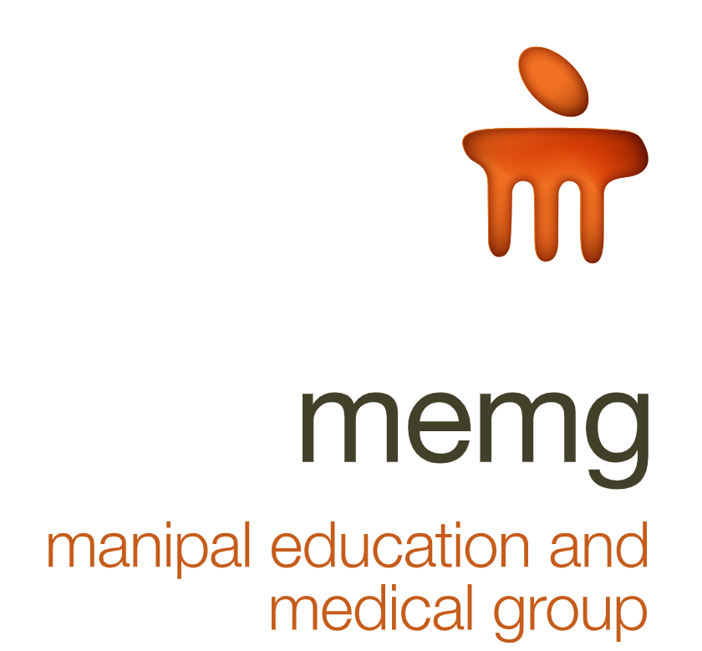








Manipal Education & Medical Group (MEMG)
Education
Ed Tech &
Talent Transformation
Health Insurance
Health Care
CAMPUS
EDUCATION
CUSTOM LEARNING
INTERVENTIONS
Charting New Frontiers In The Knowledge & Health Industry

Slide 12
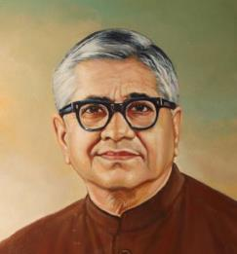









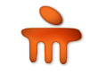












70 Years Old Knowledge Ecosystem Adapted To Digital Trends
3
19
277
Universities in India
Institutions
Courses
80
5
Countries represented
by our students
International Campuses
1 Million
Founded by Padma Shri Dr TMA Pai with the goal of empowering all strata of the society through knowledge, the Manipal Group today is a leading player in the knowledge industry through universities, healthcare, research and assessments offerings.
Distance / Online Education Students
1 Million
Professional Certified Learners
70k+
700k
Students for Online Degrees
Enterprise
Learners
Accreditations

Slide 13

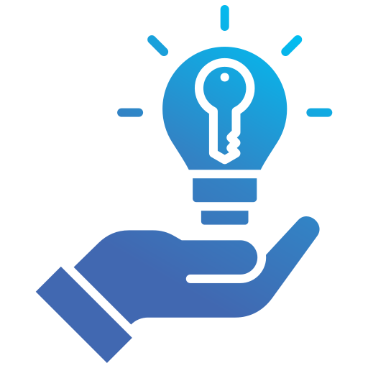

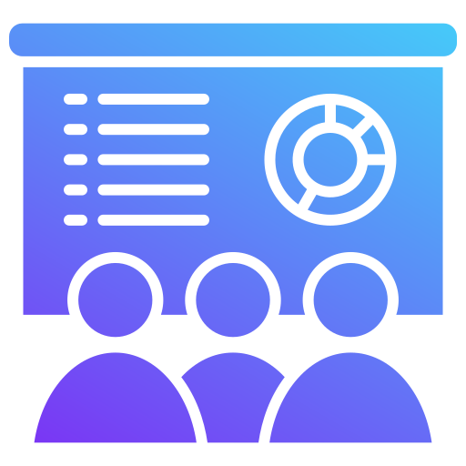

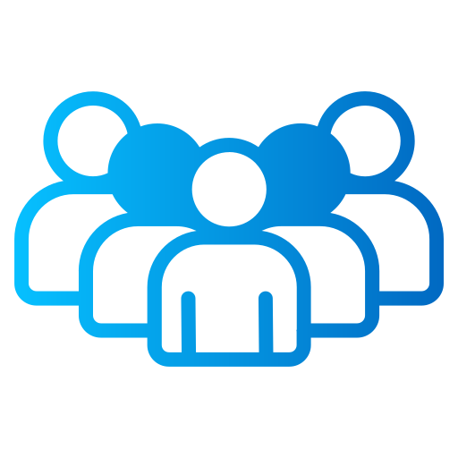

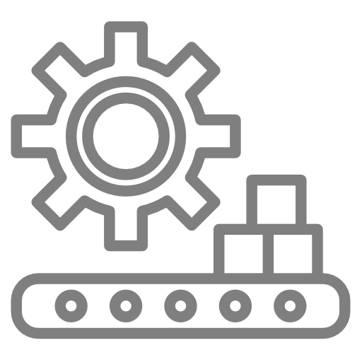










About UNext – Key Highlights
700+
Large Enterprises
16+
Years of Providing Learning Solutions
700,000
Learners Transformed Globally
40,000+
Programs (PJP, Bootcamp, RBT)
200+
In-house SME’s
1000+ Industry SME’s
Industries Served
BFSI
Manufacturing
Retail
Health Care
Transportation
Energy
Consumer Goods
Pharma
Telecom
Consulting
IT-ITES
Pure Play
Analytics
Company

Slide 14




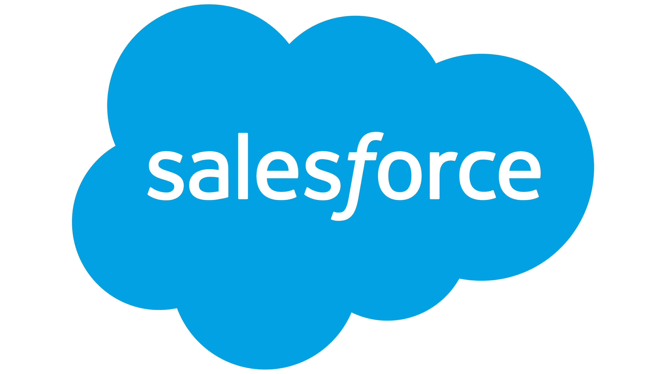
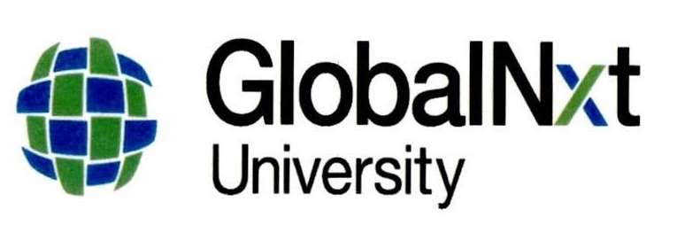

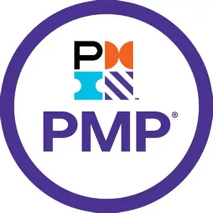
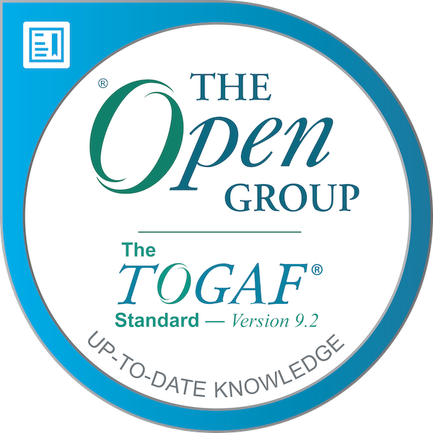
Partnerships
Universities
OEMs
Manipal
Universities
IIM Indore
The University of Chicago
GlobalNxt University
Content
Certifications

Slide 15
UNext’s Value Proposition
Built by Industry Experts
Designed by Learning Specialists
Industry Benchmark Production Quality
Content
Assess
Transformation
Delivered by Industry Practitioners
Learner Centricity
Mentoring and Coaching
Peer Learning
Learner Analytics
Gamification
Delivery
&
Engagement
Industry Specific Content
Deep Customer Understanding
Based on Learner Persona
Customized curriculum as per client needs
Context

Slide 16
Operating Landscape
Tech
Academy
HTD
WILP
AI Academy
Gen AI Academy
Work Integrated Learning Program
Hire – Train - Deploy
Power Skills
Academy
Content Development
End to End Strategic Partnership
Skill Gap Analysis
Platforms & Labs
L&D Outsourcing
The content and the program approach is strictly confidential to UNext. It is strictly forbidden to share any part of this program design approach with any third party

Slide 17


Employee Life Cycle – Need & Solution
Managing Economic Uncertainty, Geo diverse teams, Creating psychological wellness, Strategic thinking (Leadership Development,360, Coaching, Project Mentoring)
Diversity in Leadership (WLP, DEI)
Deployment readiness (Bootcamp, Content, QB)
Access to trained/certified freshers
On-Demand - Access to pool
Freshers
Senior
Executives
Pre-joiners
Mid-Level
Professionals
Early engagement (PJP)
Baseline IT & Non-IT Skills (PJP)
Incubation center at college (Content + Delivery)
JIT (Rapid skill development , Sandbox, Case Study repo)
Role based Competency Development (RBT)
Tech Career Path (RBT)
Services (Assessment , Internship)
Domain competency
Talent Retention (WILP)

Slide 18
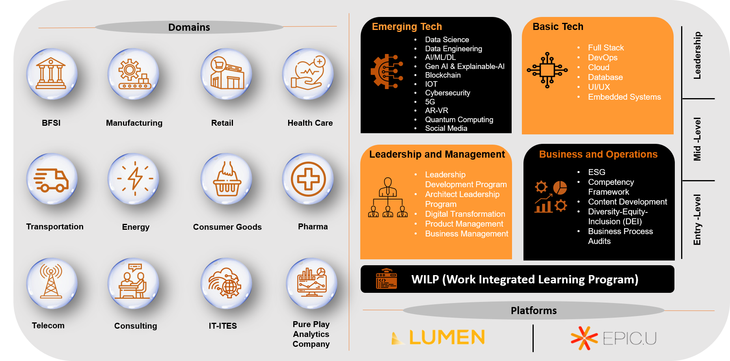
We Offer Transformation Solution Across Diverse Verticals

Slide 19
Next Steps…
1
Closure on Commercials
3
Agreement on Academic Proposal
2
4
Commercial proposal from UNext
Commence Program

Slide 20



Thank You

